Slide 1
Introduction to Software Testing Chapter 2.6
Graph Coverage for Use Cases
Paul Ammann & Jeff Offutt
http://www.cs.gmu.edu/~offutt/softwaretest/

Slide 2
UML Use Cases
UML use cases are often used to express software requirements
They help express computer application workflow
We won’t teach use cases, but show examples
Introduction to Software Testing (Ch 2)
© Ammann & Offutt

Slide 3
Simple Use Case Example
Withdraw
Funds
ATM
User
Get Balance
Transfer
Funds
Actors : Humans or software components that use the software being modeled
Use cases : Shown as circles or ovals
Node Coverage : Try each use case once …
Use Case graphs, by themselves, are not useful for testing
Introduction to Software Testing (Ch 2)
© Ammann & Offutt

Slide 4
Elaboration
Use cases are commonly elaborated (or documented)
Elaboration is first written textually
  Details of operation
  Alternatives model choices and conditions during execution
Introduction to Software Testing (Ch 2)
© Ammann & Offutt

Slide 5
Elaboration of ATM Use Case
Use Case Name : Withdraw Funds
Summary : Customer uses a valid card to withdraw funds from a valid bank account.
Actor : ATM Customer
Precondition : ATM is displaying the idle welcome message
Description :
  Customer inserts an ATM Card into the ATM Card Reader.
  If the system can recognize the card, it reads the card number.
  System prompts the customer for a PIN.
  Customer enters PIN.
  System checks the card’s expiration date and whether the card has been stolen or lost.
  If the card is valid, the system checks if the entered PIN matches the card PIN.
  If the PINs match, the system finds out what accounts the card can access.
  System displays customer accounts and prompts the customer to choose a type of transaction. There are three types of transactions, Withdraw Funds, Get Balance and Transfer Funds. (The previous eight steps are part of all three use cases; the following steps are unique to the Withdraw Funds use case.)
Introduction to Software Testing (Ch 2)
© Ammann & Offutt

Slide 6
Elaboration of ATM Use Case – (2/3)
Description (continued) :
  Customer selects Withdraw Funds, selects the account number, and enters the amount.
  System checks that the account is valid, makes sure that customer has enough funds in the account, makes sure that the daily limit has not been exceeded, and checks that the ATM has enough funds.
  If all four checks are successful, the system dispenses the cash.
  System prints a receipt with a transaction number, the transaction type, the amount withdrawn, and the new account balance.
  System ejects card.
  System displays the idle welcome message.
Introduction to Software Testing (Ch 2)
© Ammann & Offutt

Slide 7
Elaboration of ATM Use Case – (3/3)
Alternatives :
  If the system cannot recognize the card, it is ejected and the welcome message is displayed.
  If the current date is past the card's expiration date, the card is confiscated and the welcome message is displayed.
  If the card has been reported lost or stolen, it is confiscated and the welcome message is displayed.
  If the customer entered PIN does not match the PIN for the card, the system prompts for a new PIN.
  If the customer enters an incorrect PIN three times, the card is confiscated and the welcome message is displayed.
  If the account number entered by the user is invalid, the system displays an error message, ejects the card and the welcome message is displayed.
  If the request for withdraw exceeds the maximum allowable daily withdrawal amount, the system displays an apology message, ejects the card and the welcome message is displayed.
  If the request for withdraw exceeds the amount of funds in the ATM, the system displays an apology message, ejects the card and the welcome message is displayed.
  If the customer enters Cancel, the system cancels the transaction, ejects the card and the welcome message is displayed.
Postcondition :
  Funds have been withdrawn from the customer’s account.
Introduction to Software Testing (Ch 2)
© Ammann & Offutt

Slide 8
Wait A Minute …
What does this have to do with testing ?
Specifically, what does this have to do with graphs ???
Remember our admonition : Find a graph, then cover it!
Beizer suggested “Transaction Flow Graphs” in his book
UML has something very similar :
Activity Diagrams
Introduction to Software Testing (Ch 2)
© Ammann & Offutt

Slide 9
Use Cases to Activity Diagrams
Activity diagrams indicate flow among activities
Activities should model user level steps
Two kinds of nodes:
  Action states
  Sequential branches
Use case descriptions become action state nodes in the activity diagram
Alternatives are sequential branch nodes
Flow among steps are edges
Activity diagrams usually have some helpful characteristics:
  Few loops
  Simple predicates
  No obvious DU pairs
Introduction to Software Testing (Ch 2)
© Ammann & Offutt

Slide 10
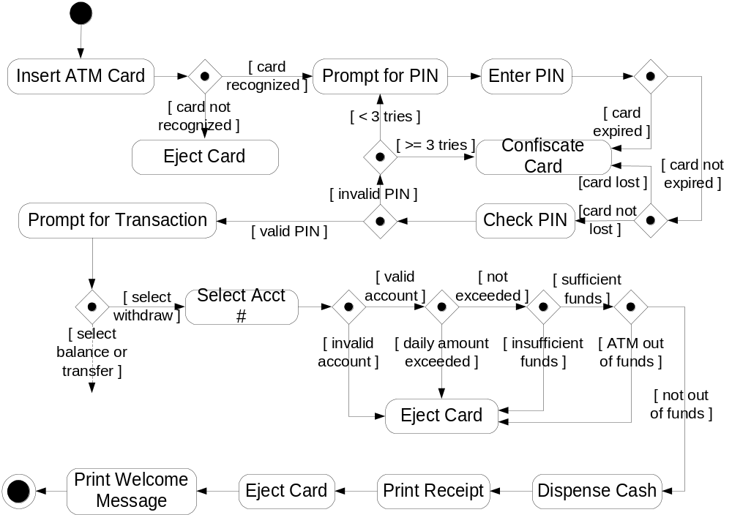
ATM Withdraw Activity Graph
Introduction to Software Testing (Ch 2)
© Ammann & Offutt

Slide 11
Covering Activity Graphs
Node Coverage
  Inputs to the software are derived from labels on nodes and predicates
  Used to form test case values
Edge Coverage
Data flow techniques do not apply
Scenario Testing
  Scenario : A complete path through a use case activity graph
  Should make semantic sense to the users
  Number of paths often finite
  If not, scenarios defined based on domain knowledge
  Use “specified path coverage”, where the set S of paths is the set of scenarios
  Note that specified path coverage does not necessarily subsume edge coverage, but scenarios should be defined so that it does
Introduction to Software Testing (Ch 2)
© Ammann & Offutt

Slide 12
Summary of Use Case Testing
Use cases are defined at the requirements level
Can be very high level
UML Activity Diagrams encode use cases in graphs
  Graphs usually have a fairly simple structure
Requirements-based testing can use graph coverage
  Straightforward to do by hand
  Specified path coverage makes sense for these graphs
Introduction to Software Testing (Ch 2)
© Ammann & Offutt

